Slide 1
Build Native Cross-Platform apps with .NET MAUI & Blazor Hybrid Workshop
Part 2 – Add Monkey Dialog

Slide 2

Event Handling
<button @onclick="AddMonkey">Add New Monkey</button>
@code {
private void AddMonkey() // EventArgs are optional
{
// MAUI Debug console
Debug.WriteLine("Add Monkey");
}
}
Notes:
Note that we at the @ sign to existing events on the HTML elements and with that we indicate that we want to refer to C# code.
You can include he event arguments and use them, but you don’t have to specify them if you won’t be needing them.

Slide 3
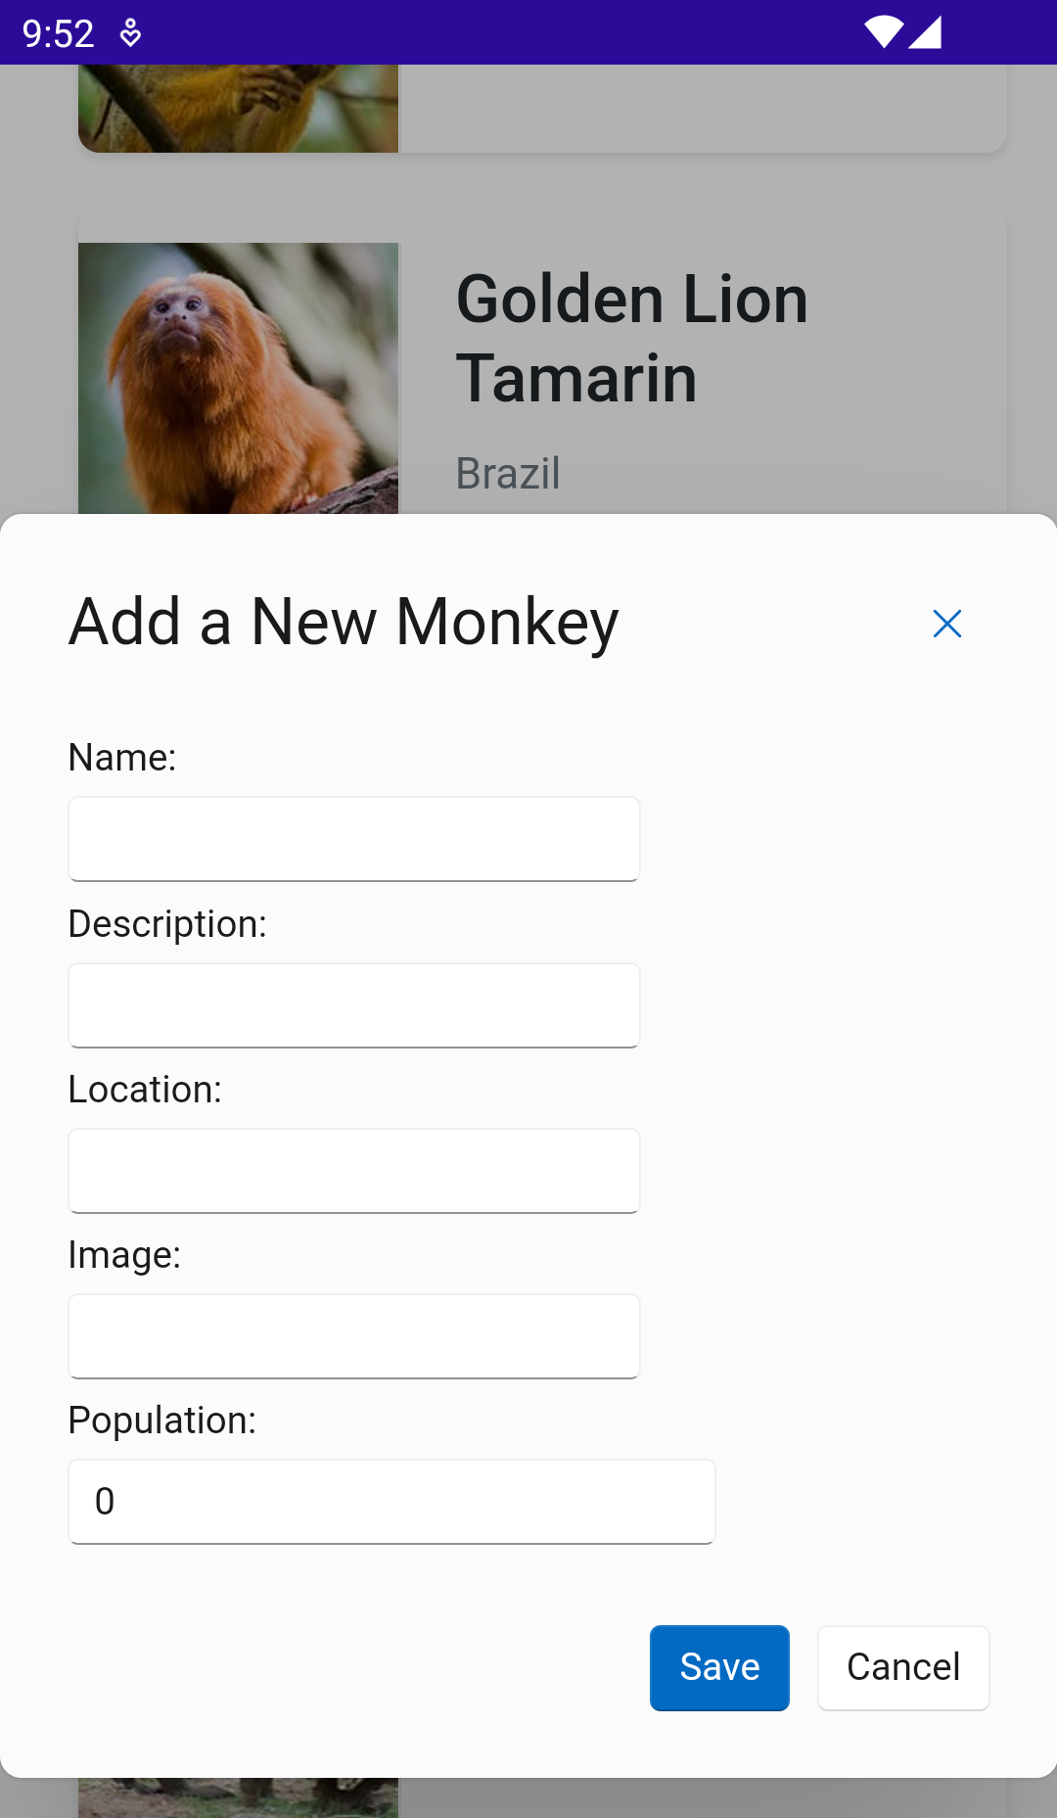
Fluent UI Blazor Components
Community library with amazing components for Blazor
We’re going to use the dialog
Implements Microsoft’s Fluent Design System
https://fluentui-blazor.net/
Notes:
To provide us with the user-interface to add the new monkey we will be using the Fluent UI Blazor Components. This is a library, created and maintained by the community for Blazor. Initially for Blazor on the web, but that doesn’t matter! You can just use any Blazor components also with Blazor Hybrid.

Slide 4
Data Binding
<p>Hi, I am @monkeyName</p>
@code {
private string monkeyName { get; set; }
}
Notes:
Data binding is a big topic and we won’t go too deep into it. Just know that if you use the @bind directive you can enable data binding and values will update automatically when you change them in the UI or update values for C# objects that you are binding to.
In its simplest form you can use the @ sign to refer to a C# variable from your markup. When implementing the dialog we’ll see a bit more advanced sample.

Slide 5
Component Parameters
// MyComponent.razor
<p>Hi, I am @MonkeyName</p>
@code {
[Parameter]
public string MonkeyName { get; set; }
}
// AnotherPage.razor
<MyComponent MonkeyName="IR Baboon">
Notes:
With the Component parameters you can set the value of an object in your component from the outside.
Notice how the property is now public and we added the Parameter attribute to it. This doesn’t just work for simple types like strings, but you can also pass complex object references in here!
Also, the filename of a component becomes the tag name, simple as that!

Slide 6
Part 2 – Add Monkey Dialog
https://aka.ms/blazor-hybrid-workshop

